Slide 1
How to Enhance the Competence in Mathematical Modeling by Implementing ‘Lesson Study’ in the Case of Volcanoes Eruption?
Subanar
Fadjar Shadiq
SEAMEO QITEP in Mathematics

Slide 2
PowerPoint Presented on The 8th APEC - Tsukuba International Conference: Innovation of Mathematics Education through Lesson Study. Challenges to Emergency Preparedness for Mathematics (III). Focus on Fire and Volcanic Eruption February 13-16, 2014. Tokyo, Japan

Slide 3
A New 2013 Curriculum in Indonesia
MoEC (2012A: 11): Requires a change in the process of learning from teacher-centered to student-centered.
The change is in the nature of learning, from textbooks oriented to contextual teaching and learning (the textbooks which contain only the subject matter to the textbooks which also contain learning materials, assessment systems and competencies expected).

Slide 4
Students should be facilitated to learn to decide things that are good and reasonable for themselves or become independent learners, students who are able to learn independently.
Students are expected to become Indonesian citizens who take responsibility and care on their nation.
The rationale of addition of hours in school (MoEC, 2012A: 11) stated that changes in the learning process should be from “the students were told by their teacher” to “the students find out by themselves.”

Slide 5
http://www.volcanodiscovery.com/indonesia.html stated that there are 147 Volcanoes in Indonesia.
North Sulawesi & Sangihe Islands (14 volcanoes): Unnamed | Awu | Banua Wuhu | Karangetang | Ruang | Tongkoko | Klabat | Lokon-Empung | Mahawu | Tondano | Sempu | Soputan | Ambang | Una Una
Halmahera (16 volcanoes): Tarakan | Dukono | Tobaru | Ibu | Gamkonora | Todoko-Ranu | Jailolo | Hiri | Gamalama | Tidore | Mare | Moti | Makian | Tigalalu | Amasing | Bibinoi
Sumatra (34 volcanoes): Pulau Weh | Seulawah Agam | Peuet Sague | Geureudong | Kembar | Sibayak | Sinabung | Toba | Imun | Helatoba-Tarutung | Sibualbuali | Lubukraya | Sorikmarapi | Sarik-Gajah | Talakmau | Marapi | Tandikat | Talang | Kerinci | Hutapanjang | Sumbing | Belirang-Beriti | Pendan | Bukit Daun | Kaba | Dempo | Bukit Lumut Balai | Patah | Besar | Gunung Semuning (Ranau caldera) | Sekincau Belirang | Suoh | Hulubelu | Rajabasa
Banda Sea (9 volcanoes): Banda Api | Manuk | Emperor of China | Serua | Nieuwerkerk | Gunung Api Wetar | Nila | Teon | Wurlali
Sunda Strait (1 volcano): Krakatau

Slide 6
http://www.volcanodiscovery.com/indonesia.html stated that there are 147 Volcanoes
West Java (17 volcanoes): Danau | Karang | Pulosari | Gagak | Perbakti | Tangkubanparahu | Tampomas | Gede-Pangrango | Cereme | Kawah Karaha | Kawah Kamojang | Endut | Guntur | Talagabodas | Kendang | Galunggung | Papandayan
Central Java (10 volcanoes): Muria | Ungaran | Dieng | Slamet | Sundoro | Telomoyo | Sumbing (Central Java) | Merbabu | Lawu | Wilis
East Java (13 volcanoes): Penanggungan | Arjuno-Welirang | Lurus | Baluran | Kawi-Butak | Kelud | Bromo | Iyang-Argapura | Lamongan | Malang Plain | Ijen | Semeru | Raung
Bali (3 volcanoes): Batur | Bratan | Agung
Sumbawa (1 volcano): Tambora
Lesser Sunda Islands (9 volcanoes): Batu Tara | Sangeang Api | Lewotolo | Paluweh | Iliboleng | Sirung | Gilbanta | Iliwerung | Ililabalekan
Lombok (1 volcano): Rinjani
Flores (15 volcanoes): Ilikedeka | Leroboleng | Ilimuda | Lewotobi | Ranakah | Egon | Poco Leok | Wai Sano | Ndete Napu | Inielika | Kelimutu | Sukaria | Ebulobo | Inierie | Iya

Slide 7
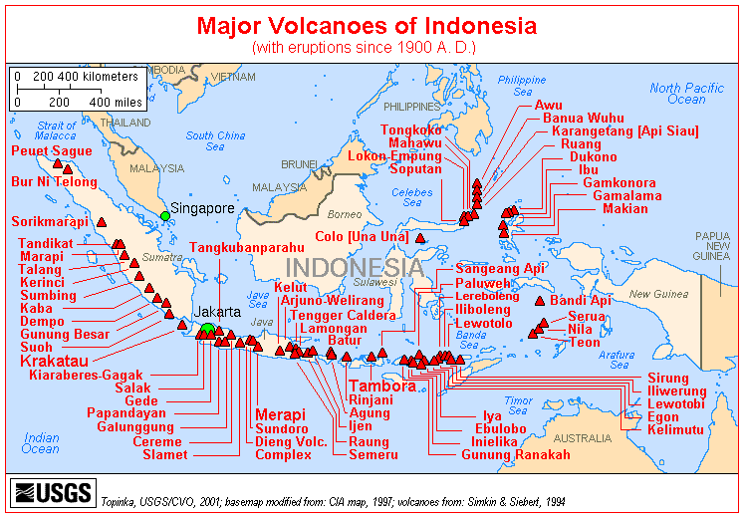
Water can be our friend, but it can be dangerous
How to control it? Technology VS Nature?

Slide 8
Comparison of Selected Volcanic Eruptions
Eruptions | Country | Location | Year | Column height (km) | Volcanic Explosivity Index | N.hemisphere summer anomaly (°C) | Fatalities
Mount Vesuvius | Italy | Mediterranean | 79 | 30 | 5 | ? | >2,000
Hatepe (Taupo) | New Zealand | Pacific Ring of Fire | 186 | 51 | 7 | ? | ?
Baekdu | China/ North Korea | Pacific Ring of Fire | 969 | 25 | 6–7 | ? | ?
Kuwae | Vanuatu | Pacific Ring of Fire | 1452 | ? | 6 | −0.5 | ?
Huaynaputina | Peru | Pacific Ring of Fire | 1600 | 46 | 6 | −0.8 | ≈1,400
Tambora | Indonesia | Pacific Ring of Fire | 1815 | 43 | 7 | −0.5 | >71,000
Krakatoa | Indonesia | Pacific Ring of Fire | 1883 | 36 | 6 | −0.3 | 36,600
Santa María | Guatemala | Pacific Ring of Fire | 1902 | 34 | 6 | no anomaly | 7,000–13,000
Novarupta | USA, Alaska | Pacific Ring of Fire | 1912 | 32 | 6 | −0.4 | 2
Mt. St. Helens | USA, Washington | Pacific Ring of Fire | 1980 | 19 | 5 | no anomaly | 57
El Chichón | Mexico | Pacific Ring of Fire | 1982 | 32 | 4–5 | YES | >2,000
Nevado del Ruiz | Colombia | Pacific Ring of Fire | 1985 | 27 | 3 | no anomaly | 23,000
Pinatubo | Philippines | Pacific Ring of Fire | 1991 | 34 | 6 | −0.5 | 1,202
Source: Oppenheimer (2003), and Smithsonian Global Volcanism Program for VEI

Slide 9
Indonesia lies in
‘The Ring of Fire’.
The Questions are:
How to Help Our Students to Learn Mathematics Meaningfully?
How to Help Our Students to Think?
How to Help Our Students to be an Independent Learner?

Slide 10
Why Lesson Study?
Subanar, Aggraeni, Iryanti, Shadiq, and Sukarman (2011:21) stated:
The three-step of lesson study: ‘Plan’, ‘Do’ and ‘See’ activities are very important in enhancing the quality of any aspect of teaching and learning process in the classroom.

Slide 11
Several Volcano Eruptions in Indonesia
Merapi Eruption in 2010 (Source: Youtube)
Sinabung Eruption in 2014 (Source: Youtube)
Anak Krakatau Eruption in 2012 (Source: Youtube)
Soputan Eruption in 2012 (Source: Youtube)

Slide 12
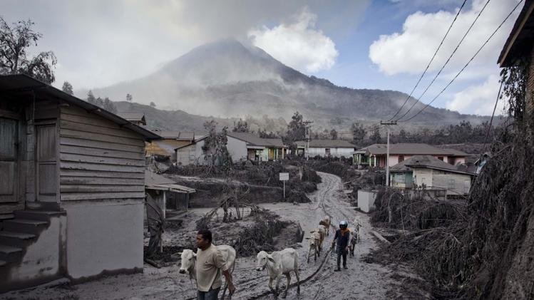
Photos of the day – January 12, 2014
Villagers evacuate their cows in an area covered by ash after their village hit by ash and mud from eruption of Mount Sinabung following further eruptions of Mount Sinabung on January 11, 2014 in Sigarang Garang, Karo District, North Sumatra, Indonesia. The number of displaced people has increased to around 25,000 in Western Indonesia as Mount Sinabung continues to spew ash and smoke after a series of several eruptions since September. Eleven deaths have now been recorded as a result of the eruptions with hundreds more falling ill. Officials expect the number of evacuees to rise as volcanic activity remains high. (Photo by Ulet Ifansasti/Getty Images) http://news.yahoo.com/photos/photos-of-the-day-january-11-2014-photo-1389553399719.html

Slide 13
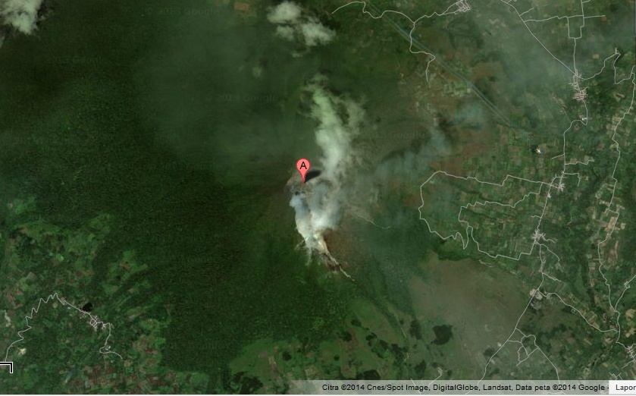
Map of Sinabung Volcano

Slide 14
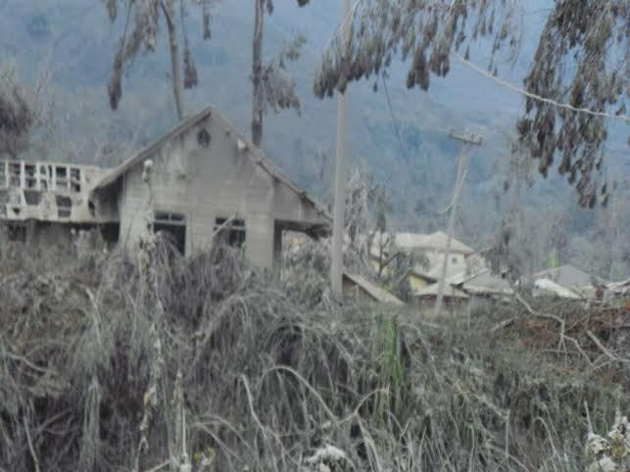
Sinabung Eruption

Slide 15
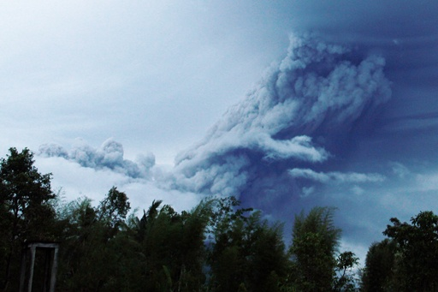
Merapi Eruption

Slide 16
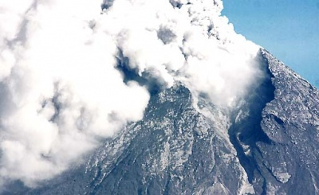
Merapi Eruption

Slide 17
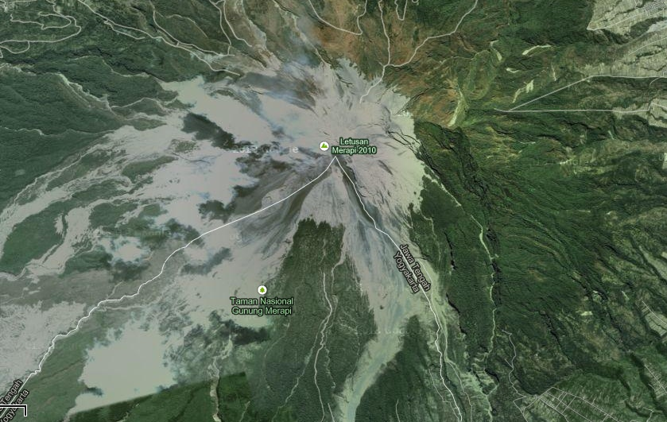
Map of Merapi Volcano

Slide 18
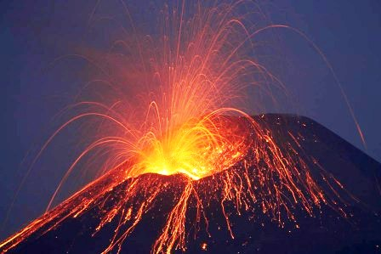
The Locus of Lahar in the Form of Parabola
Krakatau Volcano
(www.krakatau-tour.com)

Slide 19
What are the Topics (1)?
How to mitigate the people from the disaster?
How to prepare the people to anticipate from the disaster?
What are the factors that affect the speed of the burning lava?
What are the factors that affect the speed of the cold lava?

Slide 20
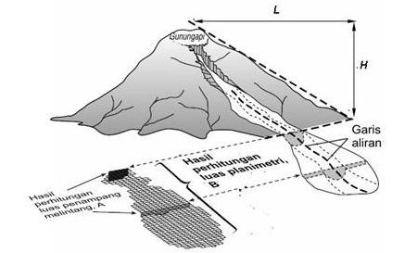
What are the Topics (2)?
Parabola → y= ax^2 + bx + c
The Speed of Flow (m/sec) based on the mean of debit and the Slope of river →
V = 2.1 Q^{0.33} S^{0.33}
The length of sediment of Alluvial Fan (m)
Lr = 15 M^{1/3}

Slide 21
Year 2014
Programs

Slide 22
Plan → Do → See
Exemplary Teaching & Learning Process

Slide 23
PURPOSES OF THE DEVELOPMENT
To increase the awareness of students on the danger of disasters in their daily lives.
To help and facilitate Indonesian students with the scientific and practical knowledge about disaster risks and related skills to reduce or minimize it.
To increase students’ beliefs on the importance of mathematics, science, and technology.
To increase the awareness of Indonesian students to predict and anticipate the earthquakes and tsunamis.

Slide 24
What are the Strategies?
Preparing the “Reading from Internet.”
2. Asks students:
What important things that you can say concerning the volcanic eruptions in Indonesia?
What questions can you ask concerning the volcanic eruptions in Indonesia?
What can you learn more concerning the volcanic eruptions in Indonesia?
What will you do concerning the volcanic eruptions in Indonesia?

Slide 25
Phase | Months | Activities
1 | Jan-April, 2014 | Shared experiences and developed the tentative materials and planed of lesson study
2 | May-July, 2014 | Wrote the e-textbook
3 | August, 2014 | Tried Out and Revision. Each class will be observed by 10 of its neighboring mathematics teachers.
4 | Sept – Nov, 2014 | Reflection and Wrote the Report

Slide 26
THE RESULTS
Two modules in pdf and d-book version
Module for Grade 9 Junior Secondary School Students: Parabola
Module for Grade 10 Secondary School Students: Exponential Number

Slide 27
Thank You
Very Much

